Slide 1
Enterprise Fellowships Webinar
Dr Anne-Louise Holloway
Dr Emer Cahill
15 May 2025

Slide 2
Webinar Information
Short, one-way PowerPoint presentation with voiceover
Presented by Dr Anne-Louise Holloway and Dr Emer Cahill
We will walk you through the presentation and answer questions at the end
You may submit questions by typing them in the Q&A box on the bottom of the Zoom screen-please try to be concise
Recording of the webinar (with closed captioning) will be available on the Research Ireland Enterprise Fellowship programme page at: https://www.researchireland.ie/funding/enterprise-fellowships/
Programme Overview
Placement Stream
Partnership Stream
Q&A

Slide 3







Enterprise Fellowships Team
Aisling McEvoy
Head of Enterprise Partnerships
Anne-Louise Holloway
Scientific Programme Manager
Suzan Gunbay
Scientific Programme Officer
Nikki Spillane
Administration Manager
Linda Rose
Assistant Director
Researcher Development
Emer Cahill
Programme Manager
Kerry O'Leary
Programme Officer

Slide 4


About Research Ireland
Taighde Éireann – Research Ireland
Competitive research and innovation funding agency in Ireland
Key action of Impact 2030
Established on 1st August 2024 - amalgamation of Science Foundation Ireland (SFI) and the Irish Research Council (IRC)
Agency of the D/FHERIS working in collaboration with HEIs and other state agencies such as the HEA, IDA Ireland and Enterprise Ireland
The annual budget for the agency is approximately €300 million

Slide 5

Research Ireland Enterprise Fellowships
Supporting the exchange of knowledge and expertise between academia and enterprise
Prior to their amalgamation to form Research Ireland, both SFI and the IRC offered a suite of enterprise-facing fellowship programmes to support collaboration with enterprise. As Research Ireland works towards developing a new consolidated fellowship programme, the original SFI Industry RD&I Fellowship Programme will run one last time under the Placement Stream and the IRC Enterprise Fellowship Scheme (Postdoctoral) will run one final time under the Partnership Stream of the 2025 Research Ireland Enterprise Fellowship Programme.
The placement stream will support academic researchers (at faculty, postdoctoral and late-stage PhD level) wishing to spend time based in industry worldwide. Fellowships can be between 1 and 24 months in duration and can be taken on a full or part-time basis.
The partnership stream supports suitably qualified postdoctoral fellows or late-stage PhD students pursuing, or intending to pursue, full-time research for a period of 12 or 24 months based in an eligible research body while partnering with enterprise.
Research Ireland welcomes applications from all disciplines to either stream.
https://www.researchireland.ie/funding/enterprise-fellowships/

Slide 6
What’s new for 2025?
As Research Ireland works to align the suite of enterprise facing fellowship programmes previously offered by SFI and IRC we are making some preliminary changes to the Industry RD&I Fellowship and Enterprise Partnership Scheme Postdoctoral Programmes.
Changes to Enterprise Partnership Scheme Postdoctoral (EPSPD)
Changes to Industry RD&I Fellowship (IRDIF)
Partnership Stream
There is no longer a five years post PhD cap on applicants.
Any point on the Postdoc salary scale can be requested.
Waivers for the first-year contribution from the eligible Enterprise Partners will no longer be offered.
Placement Stream
We will accept applications from all disciplines.
Charities and NGOs are eligible partners subject to them meeting the State aid requirements set out in the Programme Call.
A third research category (Fundamental Research) has been introduced to facilitate partnerships with Charities and NGOs.

Slide 7
Research Ireland Enterprise Fellowships
Who can apply?
Who can be an enterprise partner?
The Enterprise Fellowship programme supports late-stage PhD students and postdoctoral researchers to apply to either stream.
The placement stream also allows for applications from academic members of faculty.
Each stream involves engagement from enterprise, where it is understood to include multinational corporations, SMEs, registered charity, social, cultural or not-for-profit civic organisation.
The partnership stream also allows for engagement with state agencies or an eligible public body where appropriate.
What’s on offer?
Placement stream
Fellow’s salary/teaching buy-out & mobility up to €10,000, open access costs, the Enterprise partner supports all other costs.
Partnership stream
Fellow’s salary & eligible direct research expenses of €5,000 per annum, the Enterprise Partner will be required to provide a cash contribution to the Grant equal to 1/3 the total Grant amount.

Slide 8
Overarching objectives
Collaborate
Connect research and researchers with beneficiaries and potential users
Innovation
Facilitate increased participation in RD&I by Small, Medium and Large enterprises in the regions across Ireland.
Impact
Foster impactful innovation and knowledge creation by supporting enterprise-informed research
Training
Enhance the breadth of training of researchers and their employability
Call for proposals is now open with a deadline of 15th July 2025
https://www.researchireland.ie/funding/

Slide 9
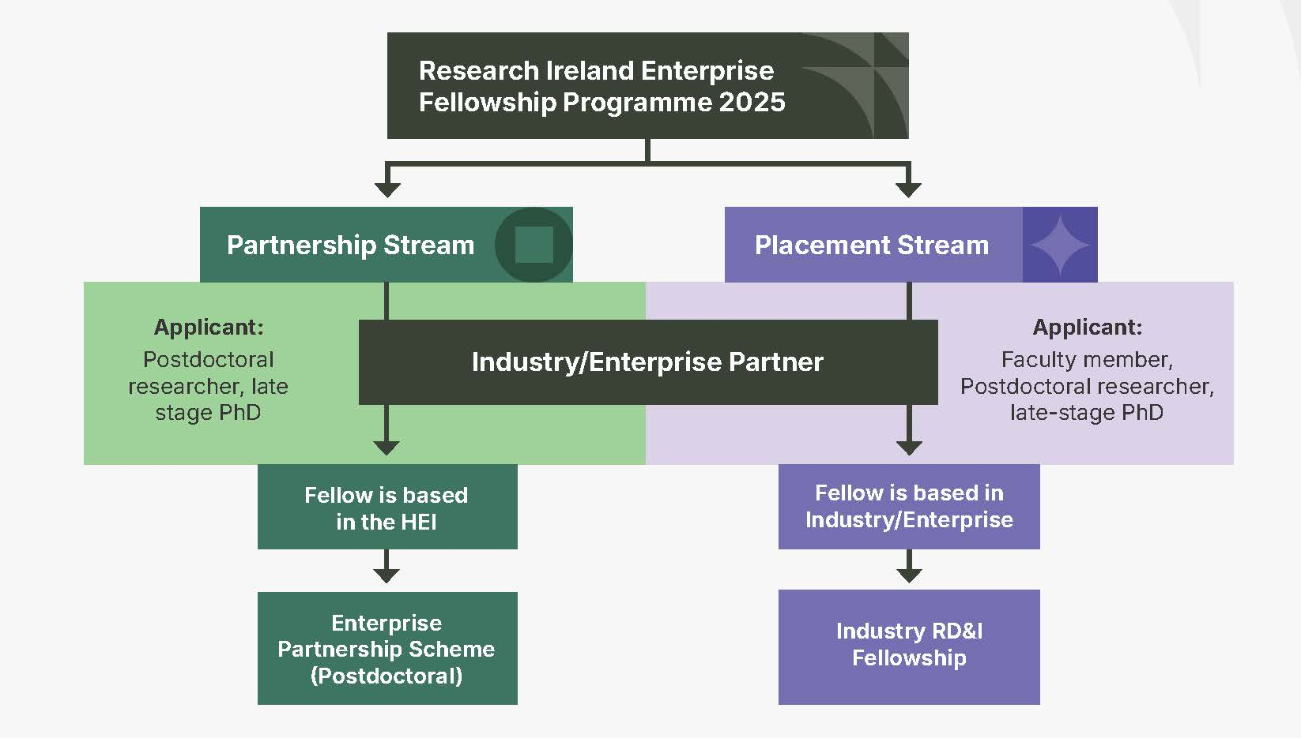
Research Ireland Enterprise Fellowships
What stream is for me?
Placement stream
Applicant: Faculty member, Postdoctoral researcher, late-stage PhD
Fellow is based in Industry/Enterprise
Industry RD&I Fellowship
Partnership stream
Applicant: Postdoctoral researcher, late-stage PhD
Fellow is based in the HEI
Enterprise Partnership Scheme (Postdoctoral)
You can only apply to one stream

Slide 10
Dr. Anne-Louise Holloway Scientific Programme Manager Enterprise Partnerships Team
Placement Stream:
Industry RD&I Fellowship (IRDIF)

Slide 11
Placement: Programme Structure
Skilled researcher (Fellow) is embedded within the industry partner’s organisation working on a joint project, supports:
Fundamental Research
Industrial research
Experimental development
Industry partner identifies an industry mentor
Duration: Up to 12 months full-time or 24 months part-time
Research Ireland Budget: max. €100,000 – Research Ireland provides salary/teaching buy-out, open access costs and mobility support to Fellow & the industry partner supports the remaining costs of the project
The applicant is the prospective Fellow
The Fellow remains an employee of the Research Body for the duration of the Fellowship
The Fellow must be located at the industry partner’s premises for the full placement duration of the fellowship
Application Deadline:
13:00, 15 July 2025
Notification to Applicants in November 2025
Earliest Start Date: January 2026
Industry RD&I Fellowship
Faculty, Postdoctoral or late-stage PhD researcher carries out research in industry, anywhere in the world.
Applicant = Fellow
Max. Research Ireland contribution
€100,000
Salary/teaching buy-out, Mobility & Open Access Costs

Slide 12
Why Apply to the Placement Stream?
Benefits to academic researchers
Benefits to the industry partner
Why apply?
Researchers placed into industry will have the opportunity
to gain a working knowledge of relevant business drivers
(e.g., intellectual property, regulatory, investors and
markets). The upskilling and industry exposure provided
to postdoctoral researchers will prepare them for a career
in industry and maximise the impact of their training so far.
For faculty researchers, it is expected that their Fellowship
will seed subsequent industry collaborations and shape the
direction of their research going forward.
Industry partners hosting researchers will benefit from
the expertise of the fellow embedded in their enterprise
bringing innovative solutions to industry challenges;
providing support to enhance competitive advantage and
future resilience and development of links with academia
to seed future longer-term collaborations.

Slide 13
Placement Stream: Who Can Apply?
Faculty Researcher
(Category A)
Prof.
Assoc. Prof.
Postdoctoral Researcher (Category B)
Current Postdoc. Researcher in eligible Research Body
Assist. Prof./Lecturers
Former Postdoc. Researcher in eligible Research Body
Late-stage PhD student
(Category C)
Holders of PhDs awarded by eligible Research Bodies
registered at an eligible Irish Research Body & in the final 6 months of their PhD
Application is led by the Researcher
in collaboration with an industry partner
NOTES
Please refer to the programme call document for full details on the eligibility criteria for each applicant category
Category B includes Research Fellows
Successful Category C applicants must have completed their PhD before they commence their Fellowship.
Category C applicants must include their current PhD supervisor as an Academic Collaborator on their application.
Proposals are not accepted from applicants who wish to be hosted in an organisation in which they have a financial interest or hold a decision-making role.
Only one Fellowship application per applicant is permitted.
Call Document: https://www.researchireland.ie/wp-content/uploads/2025/04/Enterprise-Fellowship-Programme-Placement-Stream-2025-Call-Document.pdf

Slide 14
Placement Stream: Partner Eligibility
An industry partner can be a company (SME or multinational), registered charity, social, cultural or not-for-profit civic organisation
Research Ireland provides a fixed proportion of the total eligible project costs with the remaining costs to be met by the industry partner. The Research Ireland funding rate depends on the size of the enterprise and the nature of the research project.
Must have sufficient expertise to contribute to and support the proposed research project.
financial capacity to provide a contribution to the total project eligible costs*
independent infrastructure to host a prospective Fellow
Can be located in Ireland or abroad
NOTES
*In-kind contribution: there is no requirement for the industry partner to transfer funds to the research body; it needs to show that it will itself incur the costs detailed under the industry partner contribution.
Industry hosts may partner with more than one Fellow i.e. support multiple applications.
Commercial semi-state companies such as CIE, EirGrid, ESB, etc. are eligible industry partners.
Academic spinouts are eligible industry partners provided they meet all other eligibility criteria, including the disclosure of any potential conflicts of interest.
Government-funded entities such as hospitals, technology transfer offices of public entities, Government departments or other agencies of the State are not eligible partners.
Enterprise Size | # employees AND | Annual Turnover OR | Annual Balance Sheet
Small | 1-49 | <€10 M | <€10 M
Medium | 50-249 | <€50 M | <€43 M
Large | >250 | >€50 M | >€43 M

Slide 15
Placement Stream: Programme Remit
Fundamental Research*
Industrial Research
Experimental Development
Industry RD&I Fellowship Programme is open to applications from all disciplines; however, proposals submitted to this programme must fall under one of the following categories of research as defined by the EU:
The applicant, in conjunction with their industry mentor, and TTO as appropriate, is responsible for selecting a research category which appropriately reflects the proposed project activities however Research Ireland reserves the right to final assessment of project research categorisation.
The selected research category determines the level of funding support that Research Ireland can provide.
* New for 2025 Fundamental research is a type of research that is far from the market and its results are in principle widely available. To qualify as fundamental research, the work should not be linked to any industrial or commercial objectives of a particular enterprise, and a wide dissemination of the results must be guaranteed.

Slide 16
Placement Stream: Funding
Research Ireland supported costs (max. €100K)
Fellow’s Salary*/Teaching Buy-out
Mobility/Travel max €10,000
Partner supported costs
Staff time
Equipment
Open Access publishing Costs
Operating Expenses
Contractual Research
NOTES
State aid: Programme is subject to the EU Commission General Block Exemption Regulation (GBER) EU Commission Regulation (EC) No. 651/2014 which sets rules for the level of funding support that can be provided by national agencies.
The maximum funding level (AID INTENSITY) for a Fellowship project depends on:
category of research (industrial research, experimental development or fundamental research)
size of the industry partner enterprise
dissemination of results/availability of licences/Assisted Region
Research Ireland funding rate (aid intensity) can vary from 25% to a maximum of 100% of total project costs depending size of the industry partner, category of research involved & dissemination of results.
*Research Ireland team member salary scale should be used to costs the Fellow’s salary.
TOTAL PROJECT COSTS
GRANT MADE TO RESEARCH BODY
IN-KIND CONTRIBUTION

Slide 17
Placement Stream: Funding
The below table summarises the maximum aid intensity that can be granted by Research Ireland.
NOTES
The maximum funding level (AID INTENSITY) for a Fellowship project depends on:
size of the industry partner category of research (fundamental research, industrial research or experimental development)
dissemination of results/availability of licences/Assisted Region
Total Eligible Costs: applicants are required to submit a fully costed budget that includes a full breakdown of both the industry partner’s costs in supporting the project and the Research Ireland requested costs (i.e., the total eligible costs).
The requested budget (€) from Research Ireland must not exceed the permitted aid intensity (as determined by the company size, research category & dissemination) as a percentage of the total eligible costs.
Research Category | Permitted aid intensity | Research Ireland contribution | Industry Partner's contribution
Fundamental Research | 100% | max €100K: salary/teaching buy-out, mobility/travel, open access | no cost share requirement, in-kind contribution encouraged as Research Ireland cannot fund materials or equipment costs under this call.
Industrial Research | depending on enterprise size: range 50%-80% | max €100K: salary teaching buy-out, mobility/travel, open access | range: 20%-50% in-kind contribution REQUIRED
Experimental Development | depending on enterprise size: range 25%-60% | max €100K: salary teaching buy-out, mobility/travel, open access | range: 40%-75% in-kind contribution REQUIRED

Slide 18
Placement Stream: Application Process
NOTES
Read the call document carefully, if you have questions contact the RO or Research Ireland .
Read the Funding section (Section 7) of the call document in detail and understand the eligible Research Ireland costs and required contribution of enterprise in-kind costs to the project.
Start the application process in SESAME as soon as you can.
The RO submits your application to Research Ireland
Once you submit your application on SESAME, it goes to the RO for approval. The RO may need to get back to you for clarifications before submitting to Research Ireland.
Work with your RO and give them time to work.
Letters of Support required from Research Body, Research Body Technology Transfer Office & Industry Mentor.
To apply to the Industry RD&I Fellowship Programme, applicants should:
Read the Call Documentation
Find an industry partner to host you
Jointly scope project & discuss Intellectual Property
Plan Budget
Gather Letters of Support
Create Application in SESAME (incl. Budget)
Upload Your Proposal, CVs & Letters of Support
Submit to Research Office (RO)
RO Submits to Research Ireland
Industry partner submits financial documents directly to Research Ireland
https://grants.researchireland.ie/s_Login.jsp

Slide 19
Placement Stream: Proposal Submission
Note that the ‘Applicant’ will always be the prospective Fellow
Proposals will only be accepted through SESAME, the former SFI grant management system https://grants.researchireland.ie/s_Login.jsp
Research Bodies will provide the applicants with a username, password & PIN for SESAME
Detailed information on application process available in the Call Document including submission requirements in respect of file types to be uploaded, maximum upload size, font sizes etc.
Applicants must complete all mandatory SESAME profile fields (marked in red) before submitting an application.
Industry partner must submit additional (financial) documents directly to Research Ireland via email by 29 July 2025
Deadline
Submission deadline 15 July 2025 at 13:00

Slide 20
Placement Stream: Proposal Submission
Industry Partner Documentation Required
In addition to the proposal documents submitted on SESAME the industry partner is required to confidentially provide additional financial information/declarations. These documents will be used to determine eligibility of the industry partner to receive State aid.
The following documents must be confidentially provided by the industry partner to Research Ireland directly by email to irdif@reserachireland.ie from the industry partner mentor or designated representative by 29 July 2025
Please ensure that the Applicant’s Name and Proposal ID are quoted in the email subject line.
Declaration of financial capacity.
Declaration of SME status (for SMEs only).
Declaration of solvency.
Latest set of financial records (P&L and balance sheet). If the industry partner is not required to produce audited accounts, management accounts signed off by an accountant will be accepted.
Templates for the industry partner documentation are provided on the Industry RD&I Fellowship programme webpage.

Slide 21

Placement Stream: Review Process
Application Form
CVs*
Letters of
Support
Budget & Budget Justification (3 pages)
Conflict of Interest statement
Proposal document (6 pages)*
References (1 page)
Independent International Experts- 3 review criteria
Quality of the Research and Training Programme (60%)
Quality & innovative aspects of the research programme.
Relevance of the sex/gender dimension in the research area.
Quality & innovative aspects of the training programme, where appropriate, including mentoring.
Suitability &/or complementarity of the Fellow’s expertise with the research & training programme.
Potential for Impact (20%)
Potential for long-term collaboration and knowledge exchange between the participants, and their commitment to the programme
Enhancement of the career perspectives & employability of the Fellow & contribution to his/her skills development.
Potential to shape and inform the future direction of the Fellow’s research
Quality of the proposed measures to exploit & disseminate the results, including IP management plans.
Execution and Delivery (20%)
Coherence & feasibility of the work & training plan.
Appropriateness of the infrastructure & mentoring arrangements provided by the mentor.
* Template provided

Slide 22
Placement Stream: Proposal Template
The proposal content must be structured under the following 3 headings and address each sub-heading:
Research & Training
Challenge: Describe the research/technological challenges to be addressed and their relevance to the industry partner’s activities.
State-of-the-art: Describe the current state-of-the-art in the area.
Research programme: Describe the novelty and/or innovative aspects of the research programme, including work packages and detail any training activities as appropriate.
Training plan: detail any training activities as appropriate.
Applicant and Mentor: Describe the mentor’s expertise and business sector, and how the Fellow’s expertise is suitable to carry out the proposed research programme.
Impact
Describe the potential for long-term collaboration between the participants, and their commitment to the programme.
Describe how the Fellowship will enhance the career perspectives and employability of the fellow and how it will contribute to their skills development.
Describe how the proposed research will impact on the industry partner’s activities.
Describe the proposed measures to exploit and disseminate the results, including intellectual property (IP) management measures.
Applications where additional grant aid is requested for wide dissemination of results, you must detail how results will be disseminated.
Execution and Delivery
Describe how the research programme will be implemented (include a Gantt chart).
Describe the supervision and mentoring arrangements, including risk management.
Describe the infrastructure, facilities and space to be provided by the mentor. This should include details of the office, laboratory, computing, animal or other facilities as necessary, where the research will be done, including the equipment and materials that will be available.
Fellowship proposal upload (max. 6 pages)- Template provided

Slide 23
Dr. Emer Cahill Researcher Development Team
Partnership Stream:
Enterprise Partnership Scheme Postdoctoral (EPSPD)

Slide 24
Partnership Stream: Programme structure
Enterprise Partnership Programme (Postdoctoral)
Postdoctoral Fellow is based in the Research Body working on a joint project in partnership with an Enterprise partner
Enterprise partner must nominate a mentor for the award, and complete an endorsement form as part of the application
Duration: 12 or 24 months full-time
Research Ireland Budget: Research Ireland 2/3 the total value of the award, which includes the salary and research expenses for the Fellow. The industry partner provides the remaining 1/3 cash contribution.
The applicant is the prospective Fellow
The Fellow is an employee of the Research Body for the duration of the Fellowship
Application Deadline: 15 July 2025
Earliest Start Date: December 2026
Postdoctoral or late-stage PhD researcher carries out research in the research Body in Partnership with Enterprise, anywhere in the world.
Applicant = Fellow
Research Ireland contributes 2/3 total value of Salary and Research Costs. Enterprise Partner contributes 1/3

Slide 25
Why Apply to the Partnership Stream?
Benefits to academic researchers
Benefits to the enterprise partner
Why apply?
Through engaging in collaborative research projects with enterprise under this stream, researchers develop new, advanced knowledge and skills linked with enterprise and employer needs. The programme trains early-career researchers for the diversity of employment opportunities in industry, the public sector and the non-government sectors.
For the Enterprise Partner, the scheme provides a flexible route to research, talent and innovation in an area closely aligned with their strategic interests. Partners benefit from the expertise of the fellow and their supervisory team as well as access to supports and infrastructure available in the host Research Body. The scheme helps develop long term links with academia and supports future collaboration

Slide 26
Partnership Stream: Who Can Apply?
Postdoctoral Researcher
Current Postdoc. Researcher in eligible Research Body
Former Postdoc. Researcher in eligible Research Body
Holders of PhDs awarded by eligible Research Bodies
Application is led by the Researcher
in collaboration with an enterprise partner
In the final 6 months of their PhD
Late-stage PhD student
NOTES
Please refer to the programme call document for full details on the eligibility criteria for each applicant category
Successful Late-stage PhD applicants must have completed their PhD before they commence their Fellowship.
Applicants must have an Academic mentor associated with their application
Applicants can be any age or nationality
Only one Fellowship application per applicant is permitted.
An Enterprise partner can be a company (SME or multinational), registered charity, social, cultural or not-for-profit civic organisation, or a public body

Slide 27

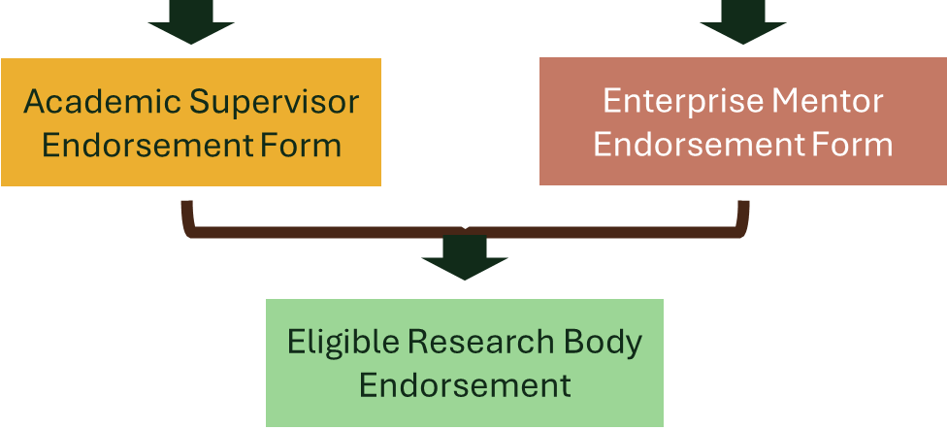
Partnership Stream: Application Process
Application Form
July 15th
•The application form is completed through the former-IRC grants management system.
•Guides to completing the form are available on the website.
•The Supervisory Team and ERB are associated with the application during this stage
July 22nd
Academic Mentor
Endorsement Form
July 29th

Slide 28
Partnership Stream: Review Process
Applications will be reviewed by Research Ireland for initial eligibility checks before being assigned to reviewers
Each application is assigned to two international peer reviewers in the same disciplinary field, interdisciplinary applications will aim to assign one reviewer from each discipline
Applications are assessed under four headings:
Applicant 30 marks);
Project (25 marks);
Training and career development (25 marks);
and environment (20 marks).
The average of the two peer reviewed scores is used to create a ranked list
All applications are discussed at a sitting panel, Chaired by an independent expert. A final ranking is agreed, and funding is offered until the budget is exhausted.
Fundable projects that fall below the cut-off for funding will be added to a reserve list.

Slide 29
Partnership Stream: State Aid
Effective Collaboration
All Research Ireland funding awarded under the Enterprise Fellowship Scheme (Postdoctoral) is subject to, and must be compliant with, State aid legislation.
Funding will be provided under the basis of the award being an effective collaboration
Enterprise Partner Documentation Required
In addition to the proposal documents submitted on SmartSimple, where appropriate, partners are required to confidentially provide additional financial information/declarations. These documents will be used to determine eligibility of the Enterprise partner to receive State aid.
The following documents must be confidentially provided by the industry partner to Research Ireland:
Declaration of financial capacity.
Declaration of solvency.
Enterprise Collaboration Form
Templates for the partner documentation will be provided on the programme webpage.

Slide 30
Why be an Enterprise partner?
Who is it for?
Benefits to the partner
Partners can be of any size
located in Ireland or abroad
Have the financial capacity to provide a contribution to the project costs
Access the expertise of the fellow
Fellow brings innovative solutions to enterprise challenges
Fellows provide support to enhance competitive advantage & future resilience
Develop links with academia to seed future longer-term collaboration
To apply
Applications are submitted to Research Ireland by the prospective fellow.
There is currently no limit on the number of applications an enterprise partner can support

Slide 31

Intellectual Property
An intellectual property (IP) rights agreement must be concluded by the Research Body with the relevant enterprise partner prior to commencement of the Fellowship.
IP agreements between the enterprise partner & the Fellow’s Research Body, are the responsibility of the Research Body & should comply with Ireland’s National IP Protocol 2019:
https://www.knowledgetransferireland.com/ManagingIP/National-IP-Protocol/
IP arrangements must reflect the collaborative nature of the project, the level of commitment of the enterprise partner & compliance with State aid regulations.

Slide 32
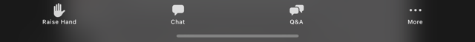

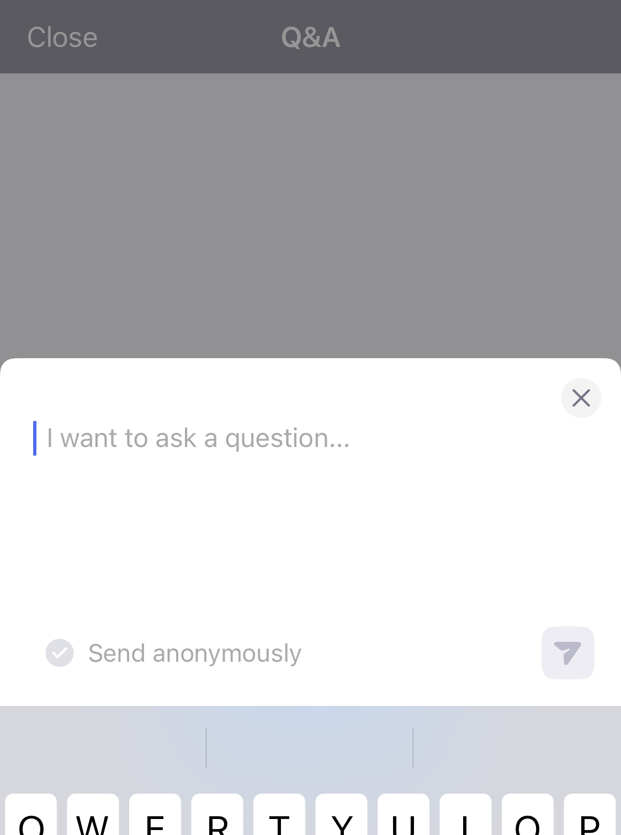

Q&A Session
We are now reviewing questions
You may submit questions by typing them in the Zoom Q&A box- please be concise
We will deal with as many of these as we can, verbally
We will post a recording of this webinar on the Enterprise Fellowship webpage

Slide 33
Closing points
You may only apply to one stream
Read the relevant programme document in detail
Ensure access to the relevant submission system
Check your eligibility to apply
Fellowship project should be developed in partnership between the applicant and enterprise partner
Allow enough time to work on the application
Engage early with the Research Body’s Research Office
Questions can be submitted after the webinar to irdif@researchireland.ie or schemes@reserchireland.ie

Slide 34
Thank you

